Slide 1

UNIVERSITY COLLEGE OF ENGINEERING AND TECHNOLOGY FOR WOMEN Vitamin Deficiency Detection System
TEAM NUMBER:08 Branch-IT
M. Umarani 22568T1831 HOD: Smt. J. Deepthi
B. Roshini 22568T1804 Guide: Smt. K. Vanisree
M. Snehalatha 22568T1832
Shireen 22568T1839
N. Nandini 22568T1834

Slide 2
CONTENTS
ABSTRACT
INTRODUCTION
EXISTING SYSTEM
PROPOSED SYSTEM
SYSTEM REQUIREMENTS
MODULES
DATAFLOW DIAGRAMS
ALGORITHMS USED
RESULT
CONCLUSION
REFERENCES

Slide 3
ABSTRACT
The Vitamin Deficiency Detection System is a web application that identifies potential vitamin deficiencies using machine learning. The project’s main goal is to raise awareness about vitamin deficiencies based on symptoms and basic health information provided by the user. In this system, user enter their symptoms and general health details through a simple, easy-to-use interface. The entered data is analyzed using a trained Random Forest machine learning model, which predicts potential vitamin deficiencies. After making predictions, the system displays the identified deficiency along with a risk level to show the severity. It also offers basic health suggestions, including dietary recommendations and lifestyle tips, and advises users to see a doctor if needed. The application stores prediction results in a database for future reference. Moreover, the system has a feature that allows users to generate and download a PDF report with their details. This project shows how machine learning and web technologies can work together to create a simple, efficient, and user-friendly system that aids in early detection and awareness of vitamin deficiencies.

Slide 4
INTRODUCTION
The Vitamin Deficiency Detection System is designed to identify vitamin deficiencies at an early stage using machine learning. In today’s lifestyle, many people suffer from nutritional deficiencies due to poor diet, lack of awareness, and unhealthy habits. Deficiencies such as Vitamin D, Vitamin B12, and Iron can lead to serious health problems if not detected on time. Traditional methods like laboratory tests and doctor consultations are effective but often time-consuming, costly, and not easily accessible to everyone, especially in rural areas. To overcome these limitations, this system provides a simple and efficient web-based solution. The application allows users to enter their symptoms and basic health details through an easy interface. A trained Random Forest model analyzes the input data and predicts possible vitamin deficiencies. Based on the results, the system provides suitable food recommendations and health suggestions. Additionally, the system includes features like nutrition tracking and report generation, helping users monitor their health over time. The main goal of this project is to create a user-friendly, fast, and cost-effective solution that improves health awareness and supports early detection of vitamin deficiencies.

Slide 5
EXISTING SYSTEM
As of now, vitamin deficiencies are mostly identified through traditional methods such as doctor consultations and laboratory tests. These methods require time, cost, and access to healthcare facilities, which may not be available to everyone. Many individuals ignore early symptoms due to lack of awareness or delay in diagnosis. There is no proper system to quickly analyze symptoms and provide instant feedback. Most people do not have access to personalized guidance regarding their nutritional status. As a result, deficiencies remain undetected for a long time, leading to serious health problems. Additionally, there is no automated mechanism to predict deficiencies or provide immediate dietary recommendations based on user inputs.

Slide 6
DISADVANTAGES
Early symptoms are often ignored or misunderstood, leading to delayed diagnosis and serious health issues
There is no quick or automated system to analyze symptoms and provide instant results.
Lack of awareness about proper nutrition and deficiency signs among people.
Traditional methods do not provide personalized dietary suggestions or continuous monitoring.

Slide 7
PROPOSED SYSTEM
The proposed AI-Based Vitamin Deficiency Detection System is a user-friendly web application designed to provide a simple and efficient way to identify vitamin deficiencies. Users can register or log in to the system and enter their symptoms and basic health details through an interactive interface. The entered data is processed using a trained Random Forest machine learning model, which predicts the type of vitamin deficiency . After prediction, the system displays the deficiency type along with confidence level, risk status, and nutrition score. It also provides personalized food recommendations and advises users to consult a doctor when necessary. The prediction details are stored in a database for future reference. Additionally, the system allows users to generate and download a PDF report containing their information, prediction results, and recommendations . This system provides a simple, fast, and digital solution for early detection of vitamin deficiencies using machine learning and web technologies.

Slide 8
ADVANTAGES
Saves time and reduces dependency on frequent medical tests.
User-friendly interface accessible to anyone.
Offers personalized food recommendations and health advice.
Stores user data securely for tracking and future analysis.
Generates PDF reports for easy access and sharing.
Helps in early detection and improves health awareness.

Slide 9
SYSTEM REQUIREMENTS
Hardware Requirements
Processor : intel i5 core or higher
Ram : 8 GB or more
Speed : 2.5 GHz or higher
Software Requirements
Frontend Technologies : HTML ,CSS , JavaScript
Backend Technologies : Python(Flask)
Database : MongoDB
Machine Learning : Sciki - learn

Slide 10
MODULES
User Authentication Module: Manages user registration and login so that only authorized users can access the system.
User Input Module: Allows users to enter personal details and symptoms required for vitamin deficiency analysis.
Prediction Module: Uses the Random Forest algorithm to analyze input data and predict the type of vitamin deficiency.
Result Display Module: Displays the predicted deficiency along with clinical explanation and risk level.
Recommendation Module: Provides dietary suggestions and basic medical advice based on the predicted deficiency.
Report Generation Module: Generates and allows users to download the prediction report for future reference.
Database Module: Stores user information and prediction history for efficient data management and retrieval.

Slide 11
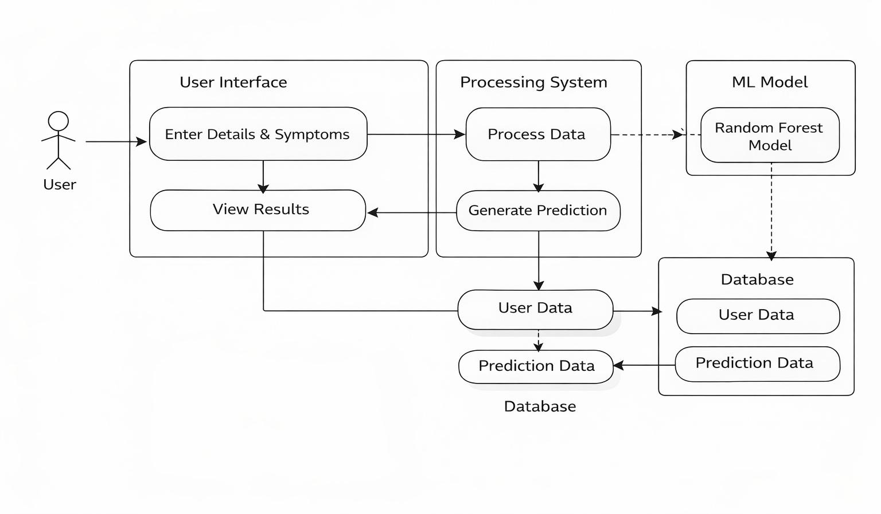
DATAFLOW DIAGRAM

Slide 12
ER DIAGRAM

Slide 13
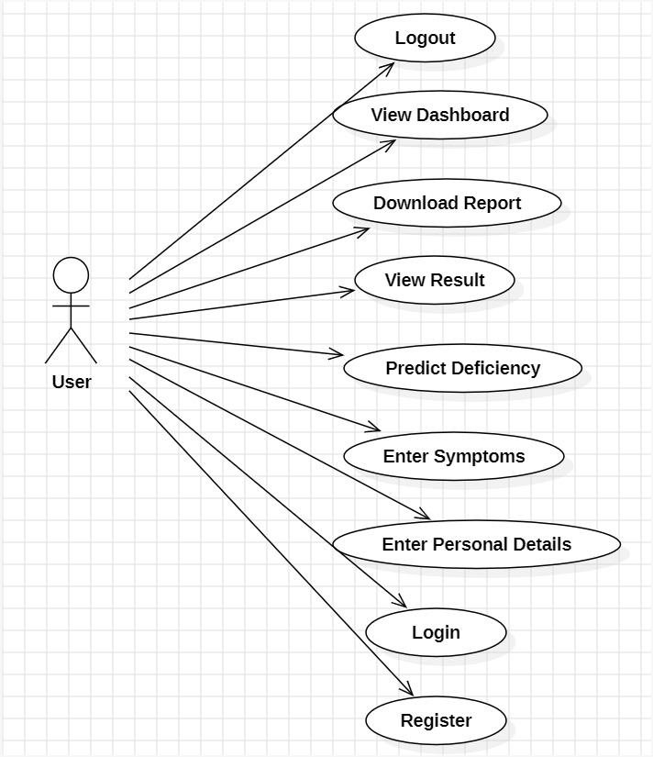
USECASE DIAGRAM

Slide 14
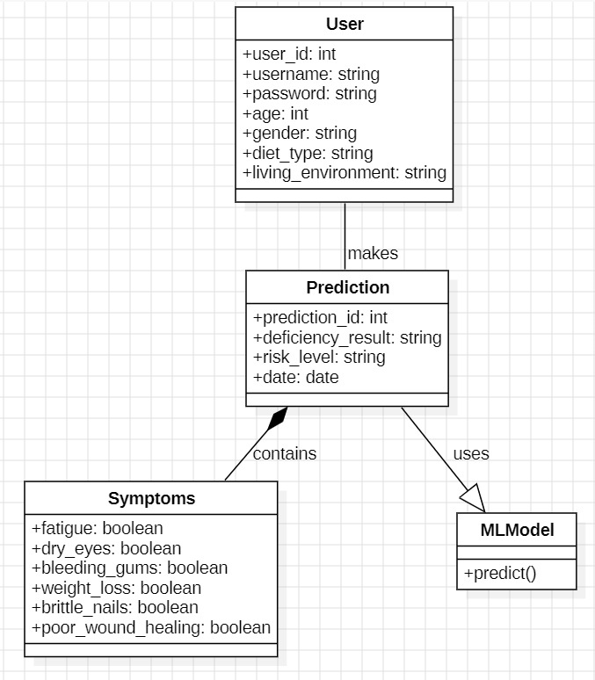
CLASS DIAGRAM

Slide 15
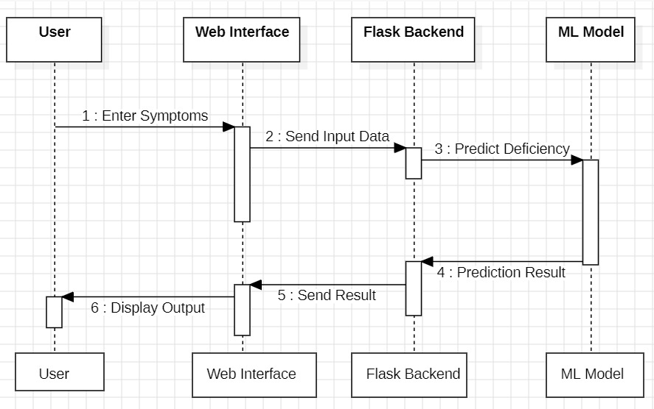
SEQUENCE DIAGRAM

Slide 16
ALGORITHMS USED
Random Forest-Based Vitamin Deficiency Prediction
Step 1: Data Collection Users enter personal details (age, gender, diet type) and symptoms (fatigue, dry eyes, bleeding gums, etc.) through the web application.
Step 2: Data Pre-Processing The input data is cleaned and converted into numerical format (e.g., Yes/No → 1/0). Missing or invalid values are handled to ensure accuracy.
Step 3: Feature Selection Important features such as symptoms and lifestyle factors are selected to improve prediction performance and reduce unnecessary data.
Step 4: Model Training (Random Forest)The dataset is used to train multiple decision trees. Each tree is trained using random subsets of data and features.
Step 5: Prediction Process User input is passed to all decision trees in the Random Forest model for classification.
Step 6: Voting Mechanism Each decision tree gives a prediction, and the final result is determined based on majority voting.
Step 7: Result Generation The system predicts the type of vitamin deficiency (e.g., Iron, Vitamin D) along with risk level.
Step 8: Recommendation Output Based on prediction, the system provides dietary suggestions and medical advice to the user.

Slide 17
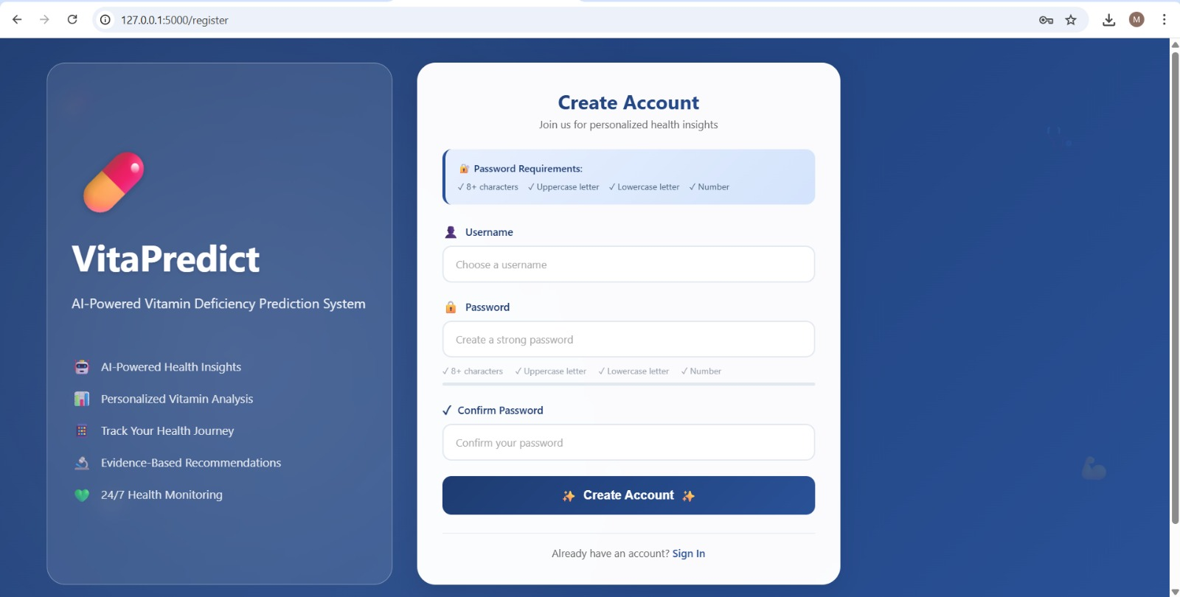
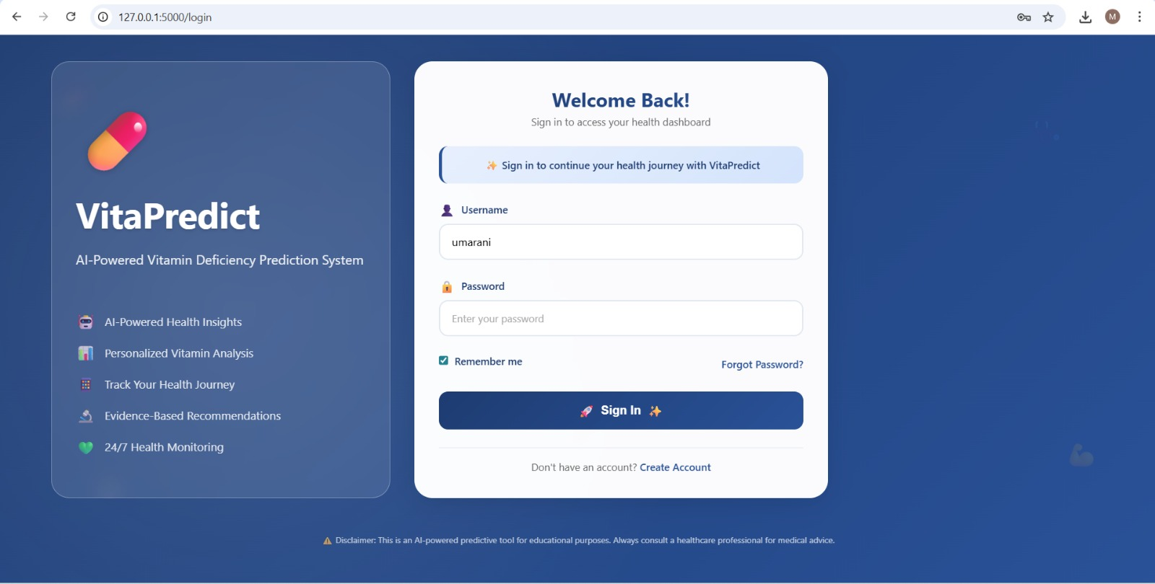
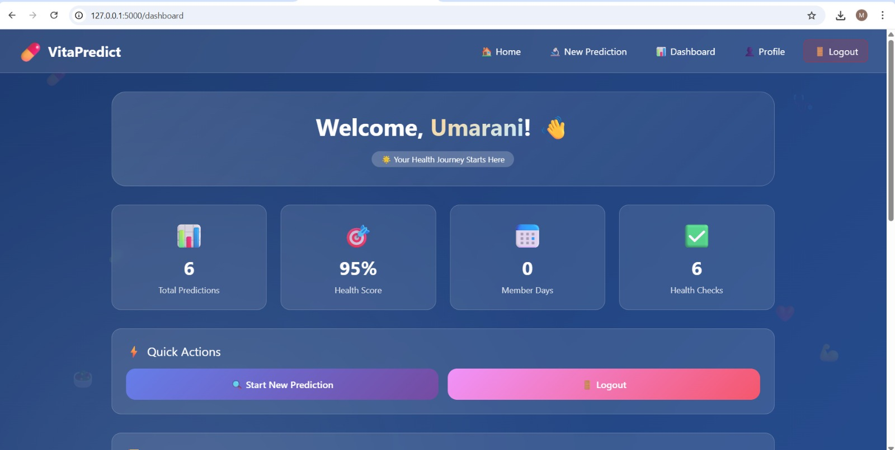
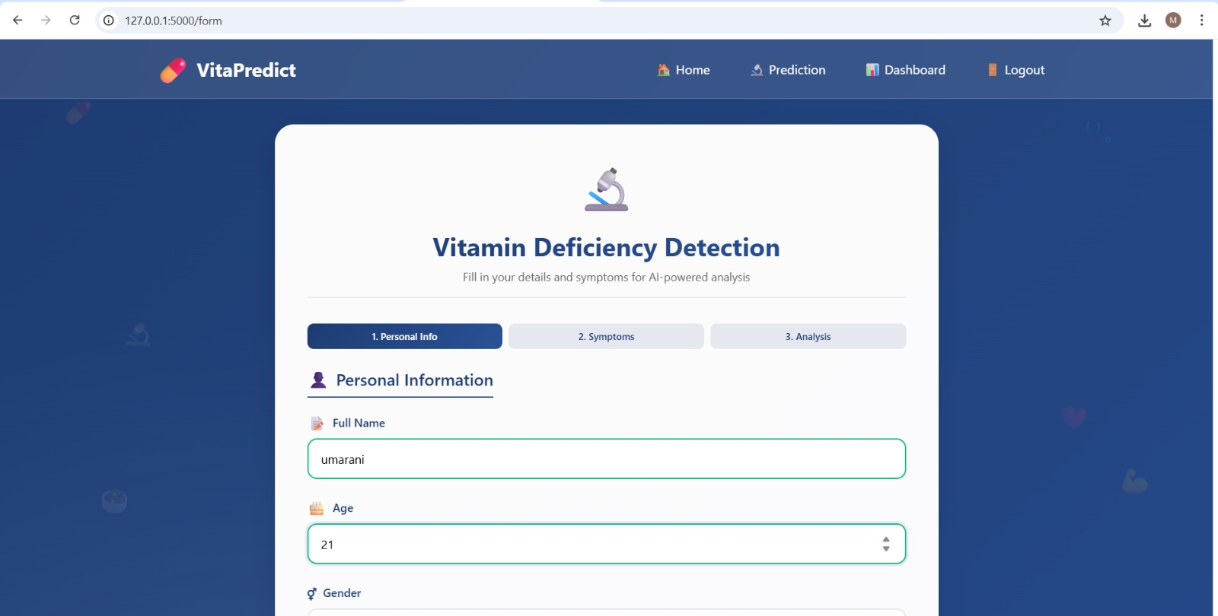
RESULT

Slide 18
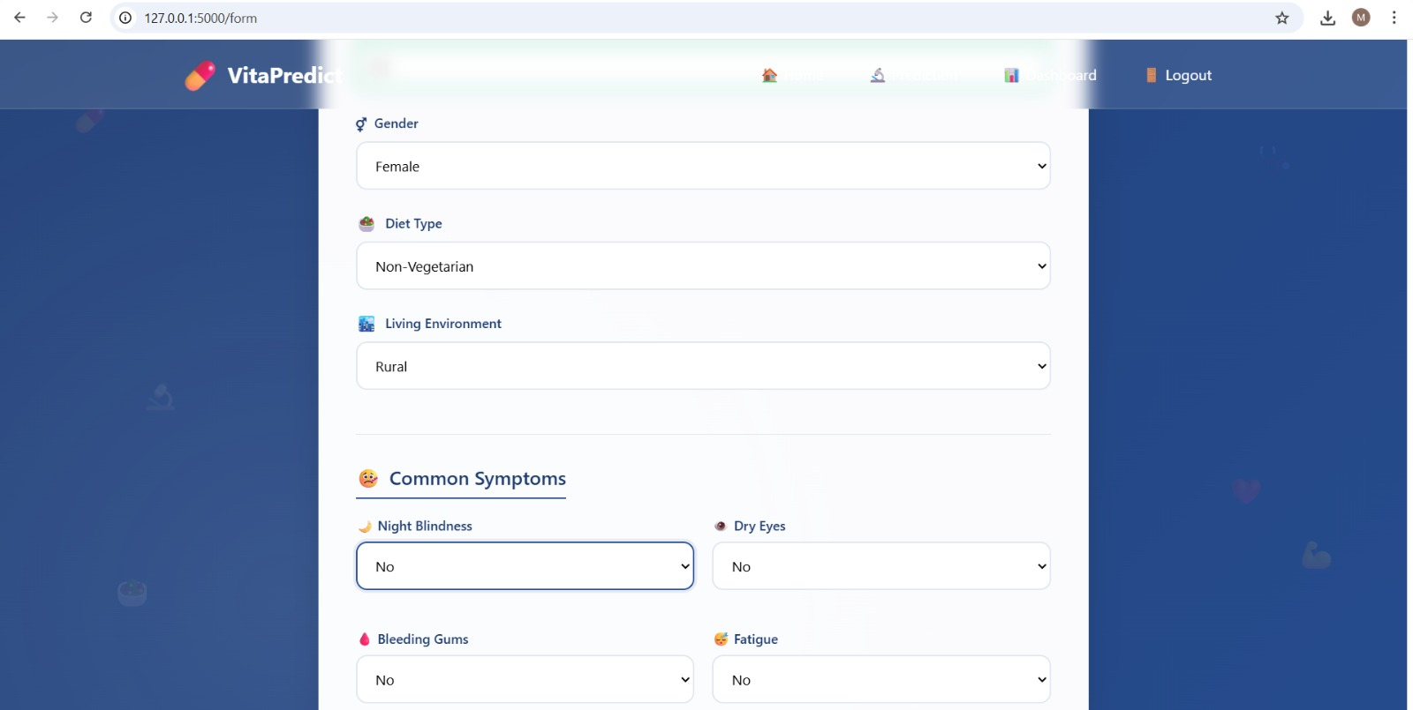
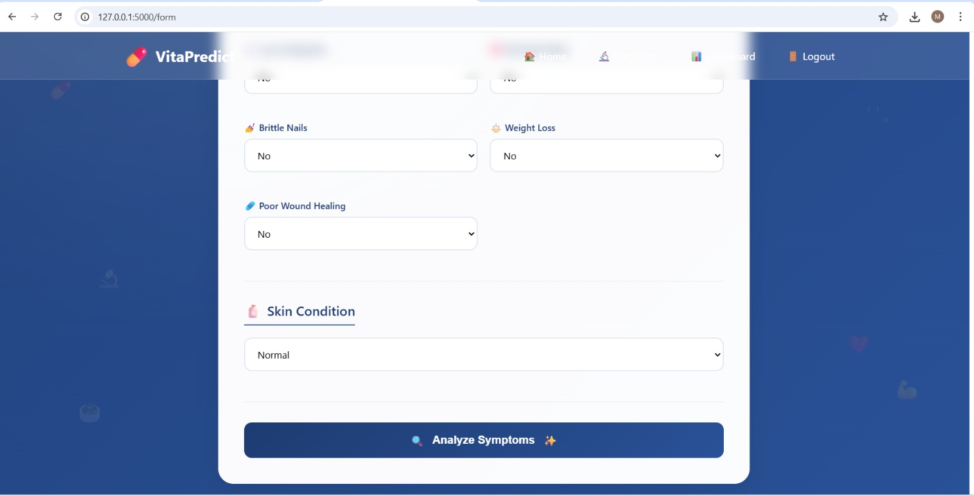
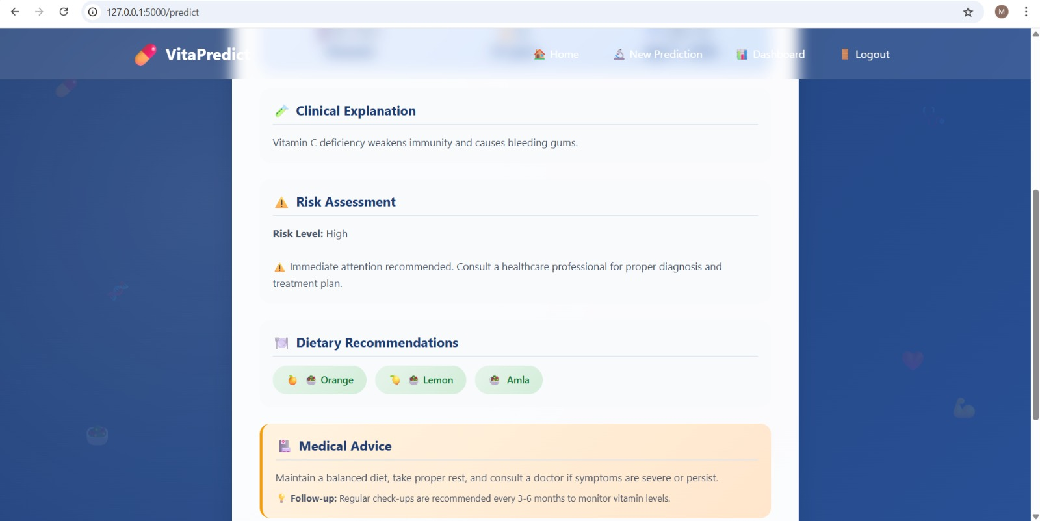
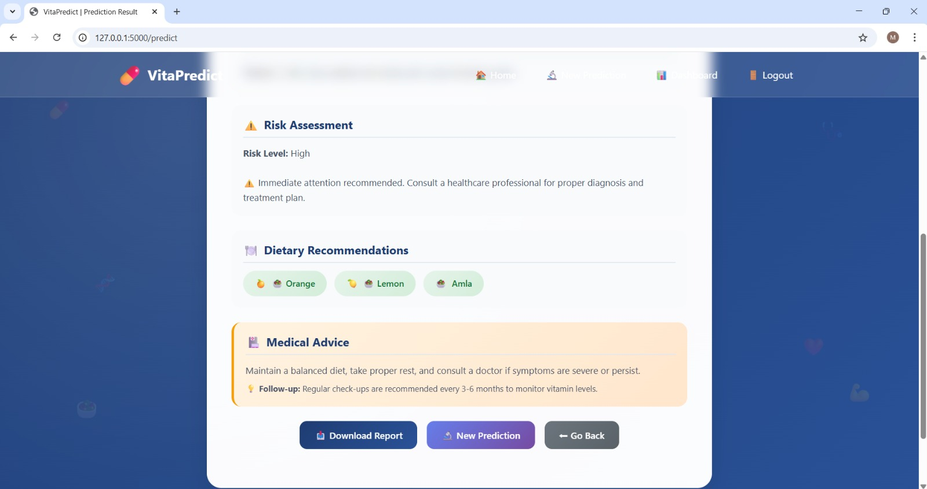
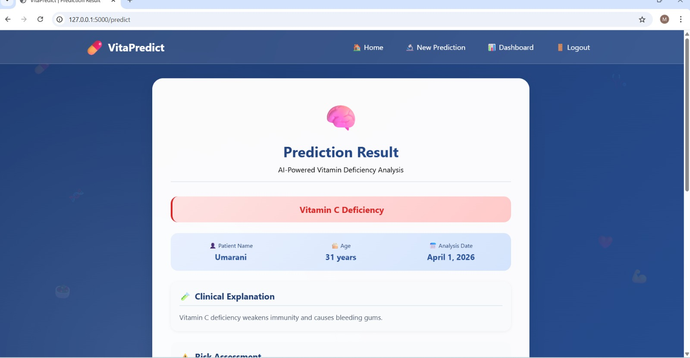

Slide 19
CONCLUSION
The Vita Predict system shows how machine learning can be used in healthcare to detect vitamin deficiencies. It analyzes user symptoms and basic details to give accurate predictions using the Random Forest algorithm. The system provides a user-friendly web interface where users can easily register, log in, and enter their symptoms. Based on the input, it gives results such as deficiency prediction, explanation, risk level, diet suggestions, and basic medical advice. This helps users understand their health condition and take early preventive steps. One major advantage of this system is that it provides instant results without the need for medical tests, making it useful for basic health screening. It also reduces dependency on manual diagnosis and gives quick health insights. Overall, the system is efficient, easy to use, and helpful for early detection of vitamin deficiencies. In the future, it can be improved by adding more advanced models, real-time data, and additional health features.

Slide 20
REFERENCES
Breiman , L, “Random Forests,” Machine Learning, vol. 45, no. 1, pp. 5–32, 2001.
Pedregosa, F. et al., “Scikit-learn: Machine Learning in Python,” Journal of Machine Learning Research, vol. 12, pp. 2011.
Siva Jyothi, P. N., “Machine Learning System using Random Forest with Flask Integration,” 2024.
“Liver Cirrhosis Prediction using Random Forest,” IJCRT, 2025.[9:34 pm, 01/04/2026] :
“Network Intru sion Detection using Random Forest and Flask,” IJSART, 2024.
Louppe G., “Understanding Random Forests: From Theory to Practice,” arXiv.
Haddouchi, M., “Survey on Random Forest Model Interpretability,” arXiv, 2024.

Slide 21
THANK YOU

